Slide 1

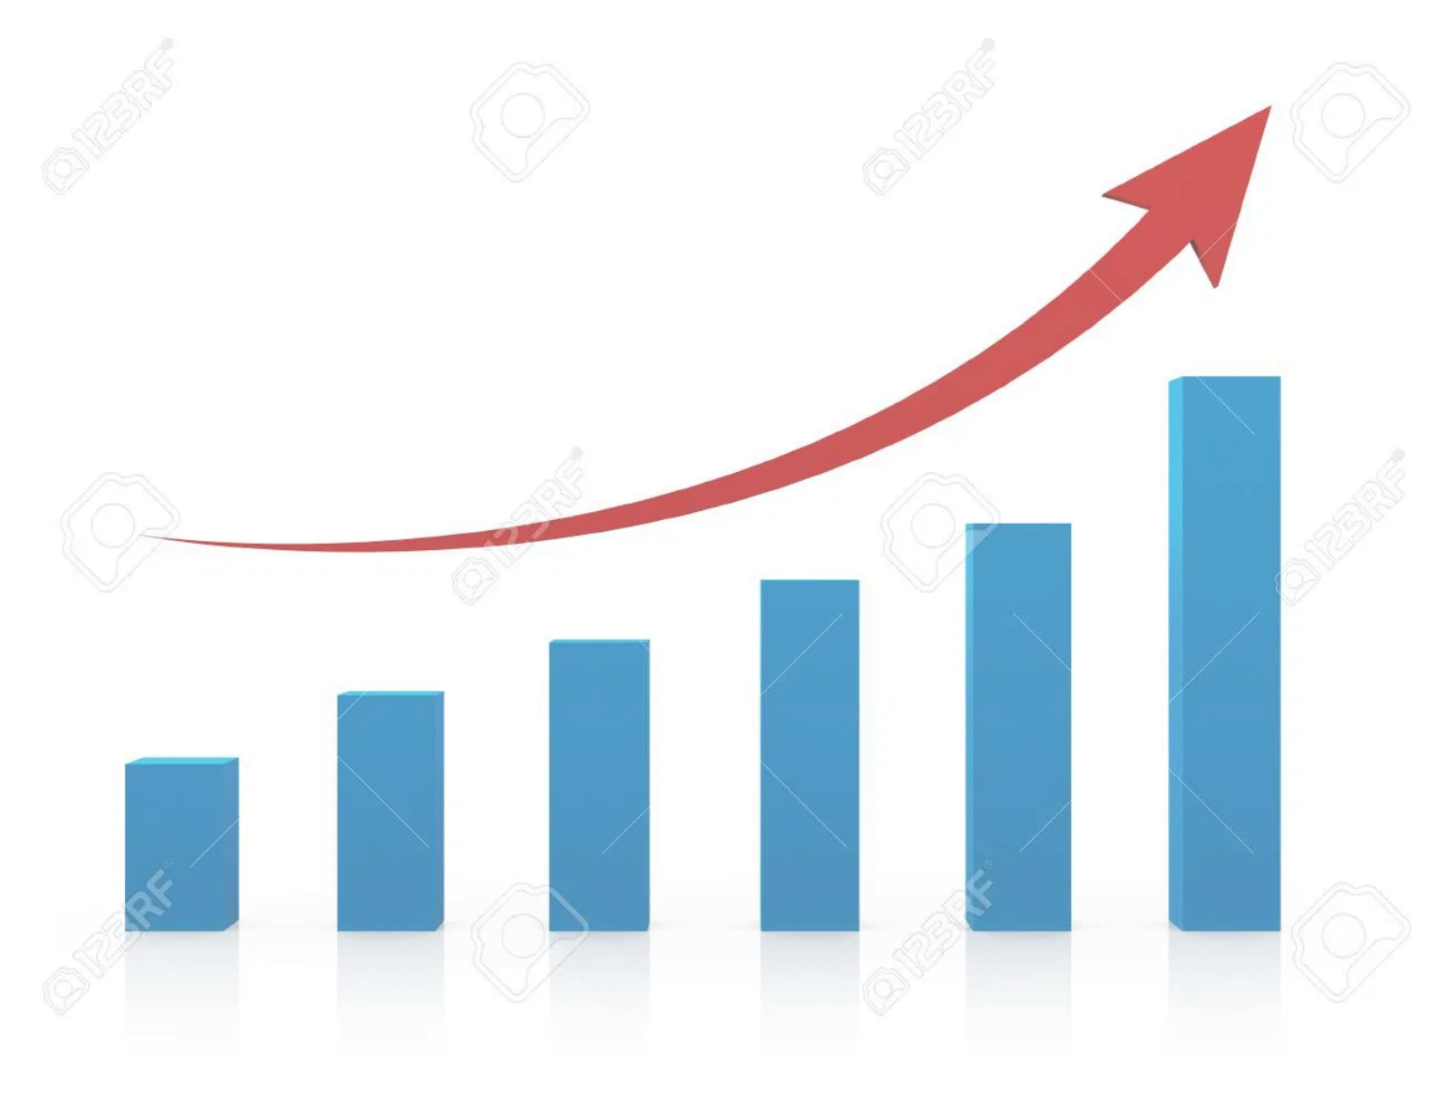




THE $50K PROFIT ACCELERATOR AUDIT
Executive Business Assessment & Strategic Opportunity Analysis
Normally Valued at $25,000 Consulting Engagement
Complimentary for Qualifying Businesses
Identify $50,000+ Hidden Opportunities
Proven 200-500% ROI Results
$1M Amazon Success Case Study
47-Point Comprehensive Assessment
Presented by NexGen Webcreators Strategic Consulting Division

Slide 2

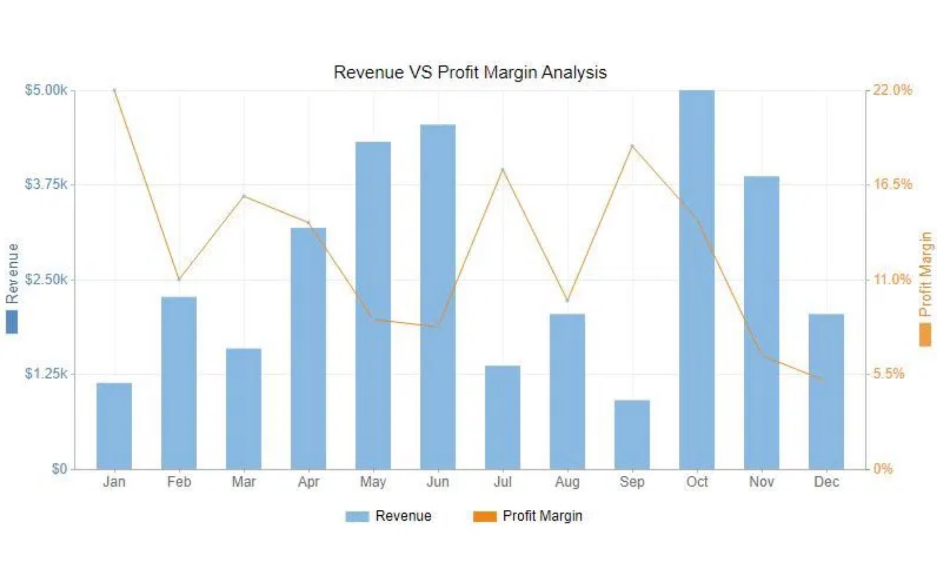





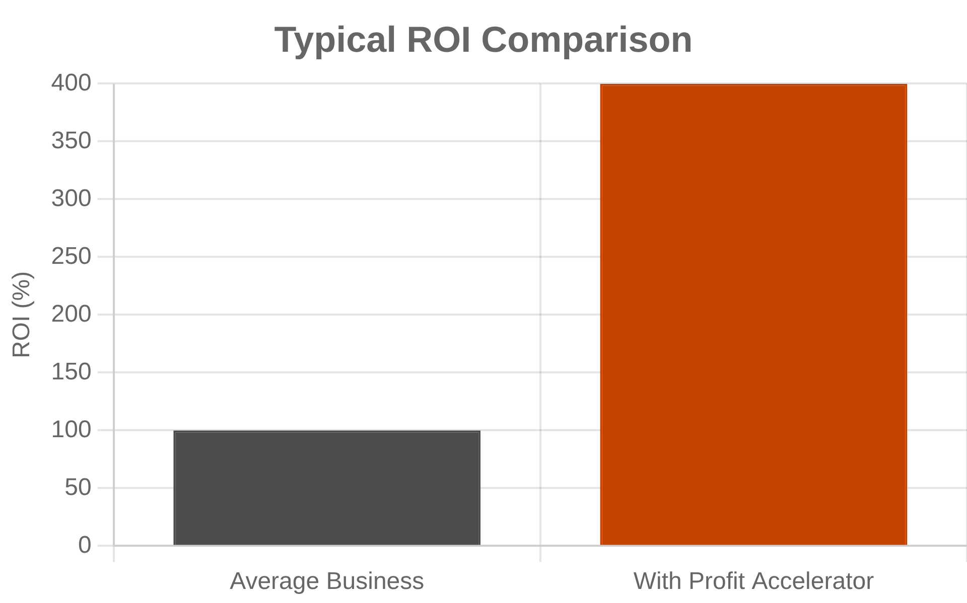




Executive Summary
Comprehensive 47-Point Business Assessment Methodology
$1,000,000+
Amazon marketplace revenue generated for one client
200-500%
Typical ROI achieved across all client engagements
47 Points
Comprehensive assessment covering all business areas
95%+
Client satisfaction rate across all engagements
What You'll Discover:
Revenue Opportunities:
$10K-200K annually in hidden profit
potential
Cost Reduction:
$15K-80K annual savings through optimization
Digital Gaps:
Thousands in lost leads from poor online presence
Operational Issues:
Inefficiencies draining profit margins
Market Position:
Premium growth and positioning opportunities
Industries Served:
Industrial Supply · Beauty Schools · Fitness Professionals ·
General Business

Slide 3

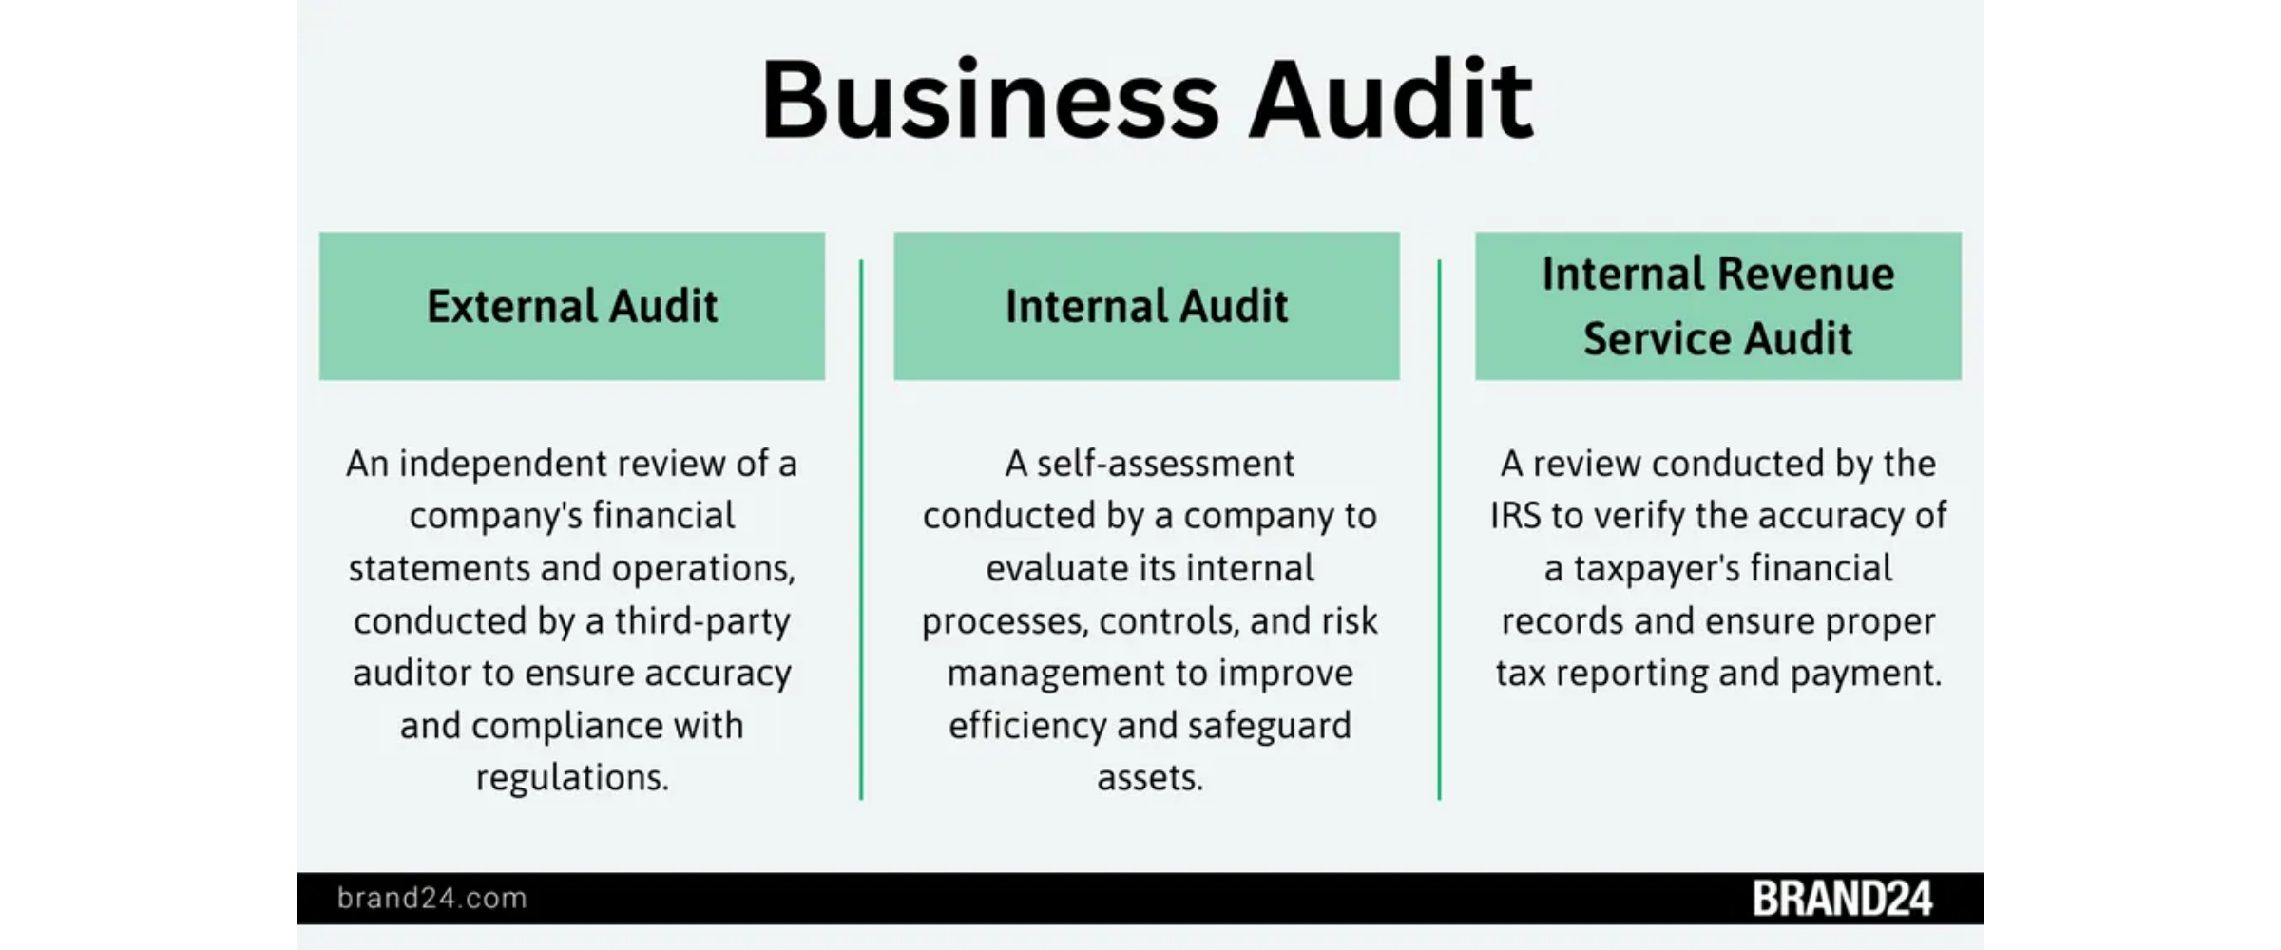




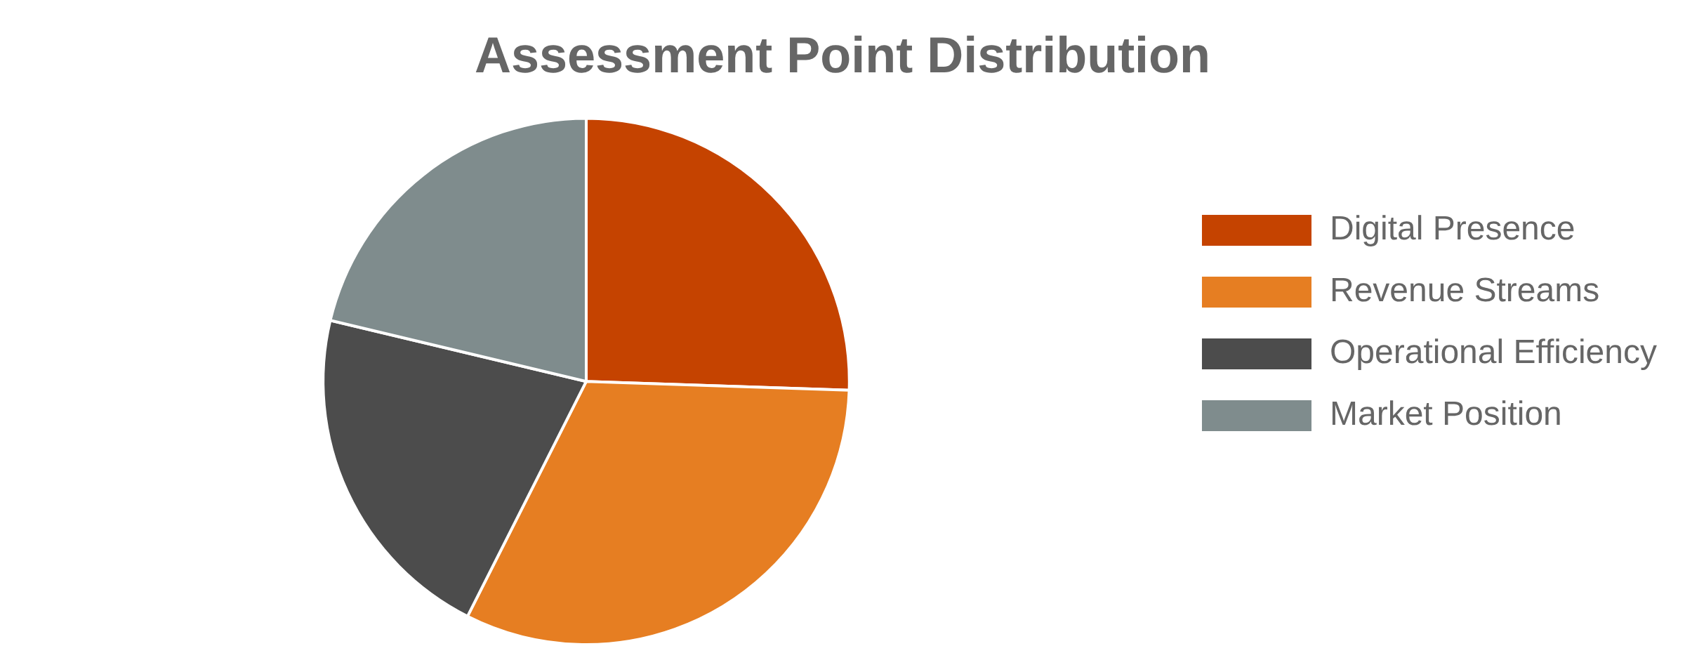
Assessment Framework
Four Core Business Evaluation Areas
Total Assessment: 470 Points
Digital Presence
(120 Pts)
Revenue Streams
(150 Pts)
Website performance
Diversification strategies
SEO and rankings
Pricing optimization
User experience
Customer lifetime value
Operational Efficiency
(100 Pts)
Market Position
(100 Pts)
Brand recognition
Supply chain optimization
Competitive advantage
Process automation
Customer retention
Resource management

Slide 4


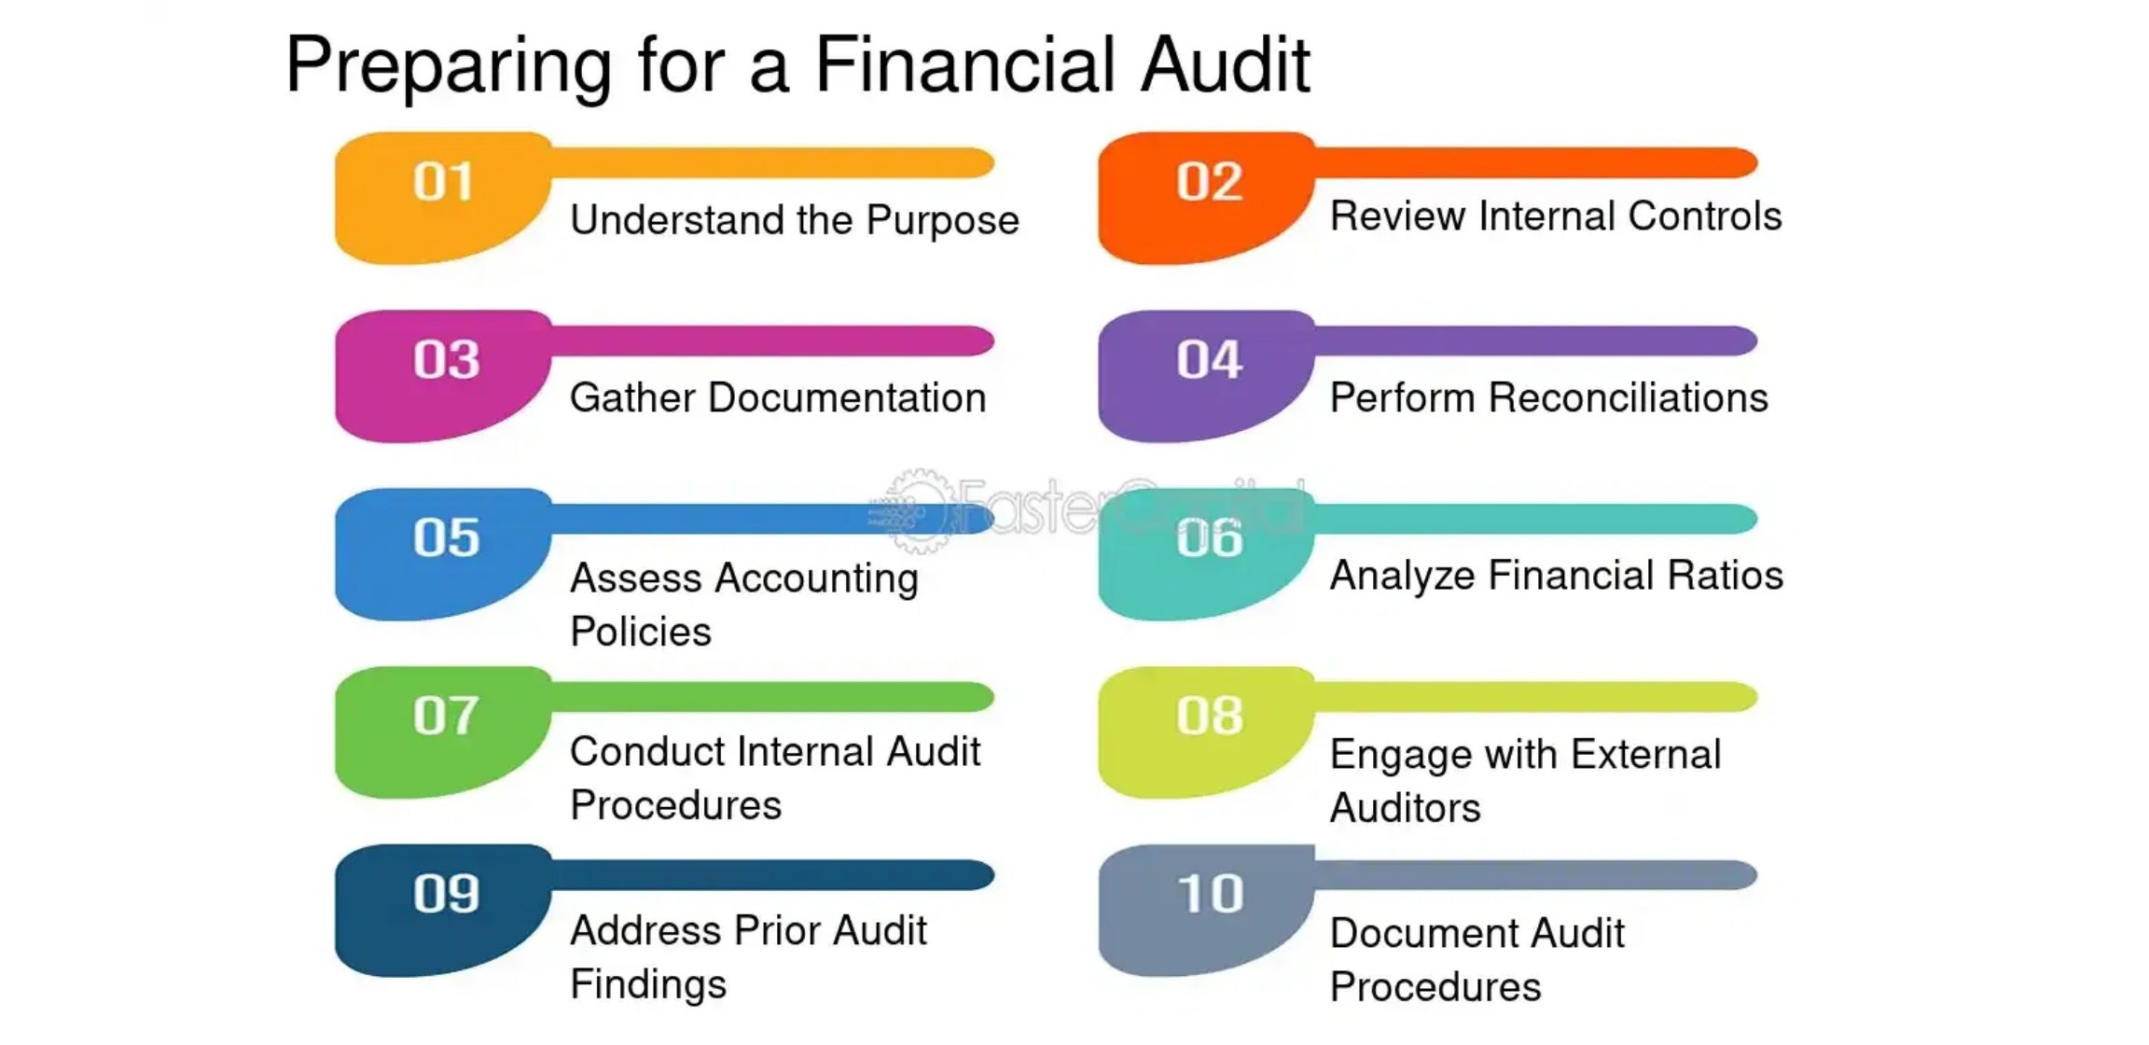

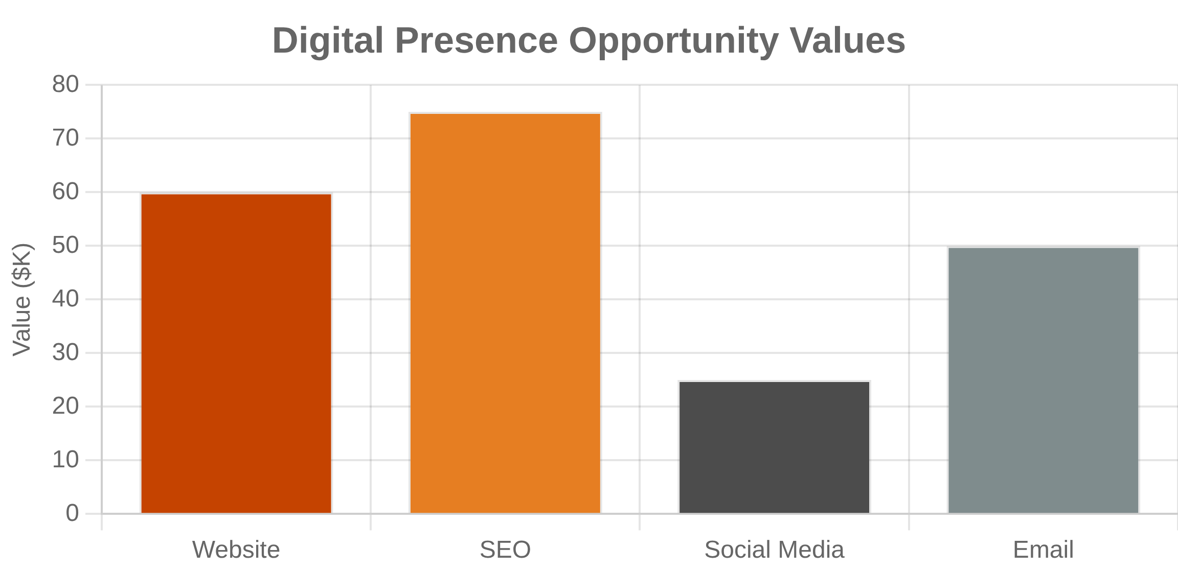

Digital Presence Audit
12-Point Evaluation of Online Performance
Website Performance
Lead Generation: How many qualified leads monthly?
Conversion Rate: Percentage of visitors taking action
Mobile Experience: Optimization for mobile devices
Page Speed: Loading time and technical performance
Search & Visibility
SEO Rankings: Position for target keywords
Local SEO: Visibility in local search results
Content Marketing: Frequency and quality of content
Online Reviews: Quantity and quality of reviews
Digital Marketing
Social Media: Engagement and follower growth
Email Marketing: Automation and nurturing sequences
Paid Advertising: ROI and campaign effectiveness
Analytics: Tracking and performance measurement
Typical Opportunities:
$8K-75K annually
per optimization area

Slide 5


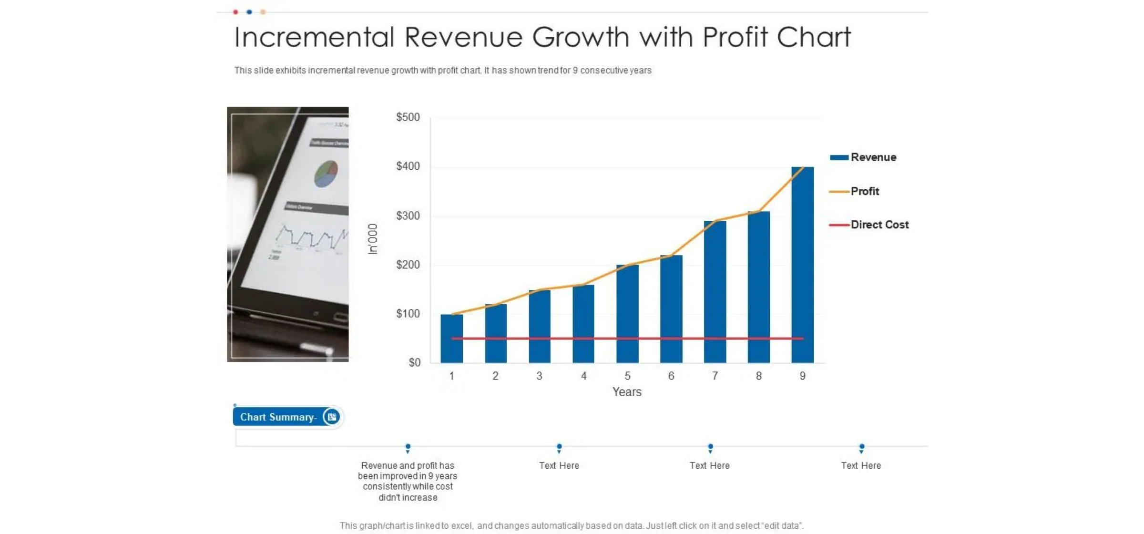


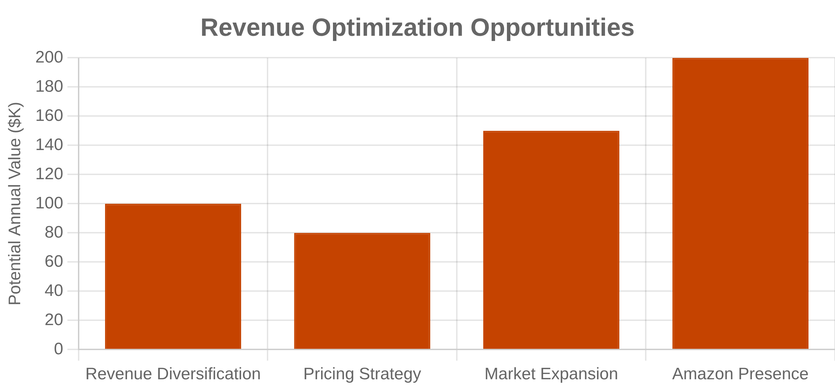
Revenue Stream Analysis
15-Point Assessment of Revenue Performance
Revenue Diversification
Number of revenue streams
Recurring vs. one-time mix
Geographic market coverage
Partnership programs
Pricing & Profitability
Pricing vs. competitors
Profit margin optimization
Customer lifetime value
Upselling effectiveness
Market Expansion
Amazon/E-commerce
New service development
Market share analysis
Innovation pipeline
Typical Opportunities: $15K-200K annually per optimization area

Slide 6


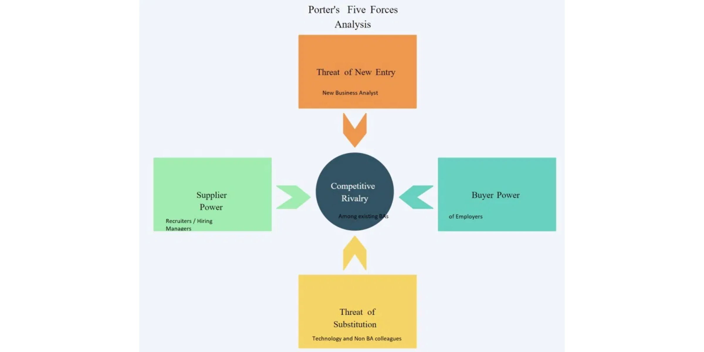


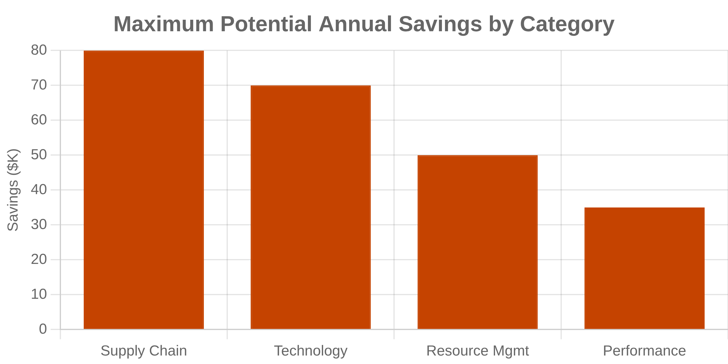

Operational Efficiency Review
10-Point Process and Cost Evaluation
Supply Chain & Vendors
Vendor relationship optimization
Supply chain cost reduction
Inventory management efficiency
Technology & Automation
Process automation level
Technology infrastructure modernization
Integration and workflow optimization
Resource Management
Employee productivity optimization
Quality control systems
Financial management efficiency
Performance Metrics
Cost per unit/service delivery
Resource utilization rates
Time-to-delivery optimization
Typical Opportunities: $8K-80K annually per optimization area

Slide 7


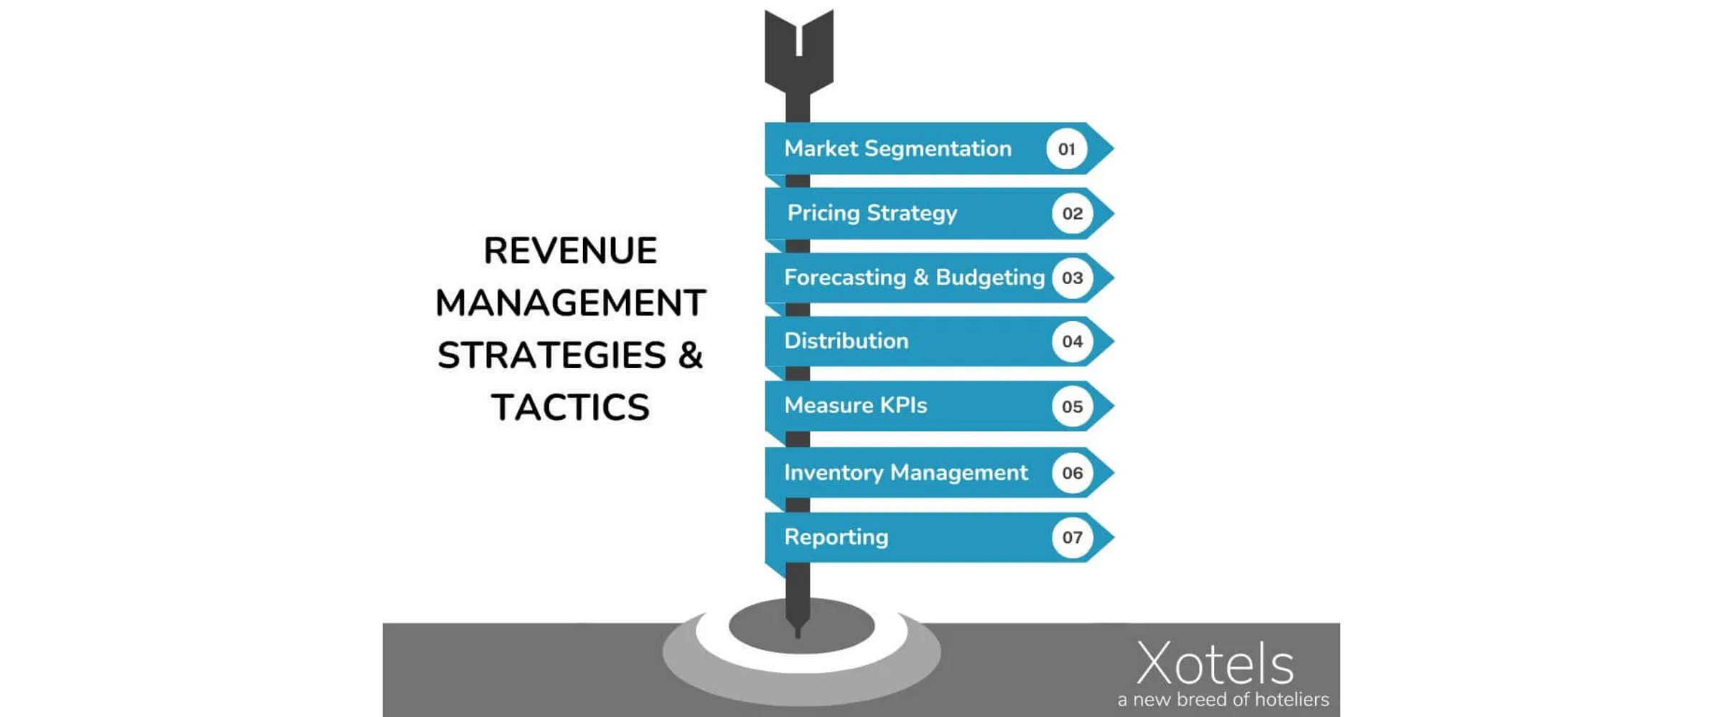


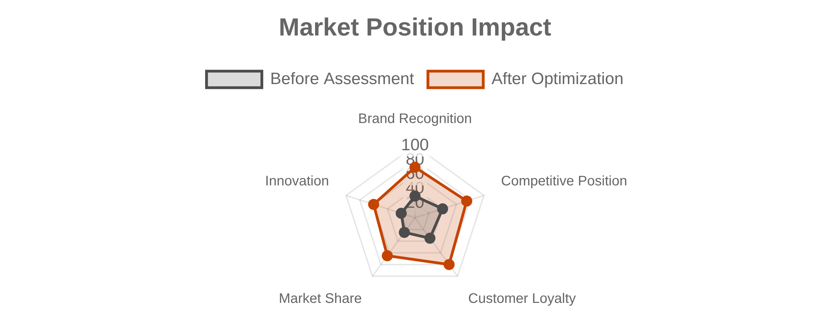
Market Position Assessment
10-Point Competitive and Brand Analysis
Brand & Recognition
Competitive Analysis
Brand awareness in target market
Market share and positioning
Competitive advantages
Online reputation and reviews
Differentiation strategies
Thought leadership positioning
Customer Relationships
Strategic Positioning
Customer satisfaction scores
Market trend adaptation
Retention and loyalty rates
Future market position
Referral generation
Innovation and leadership
Typical Opportunities: $12K-150K annually per optimization area

Slide 8

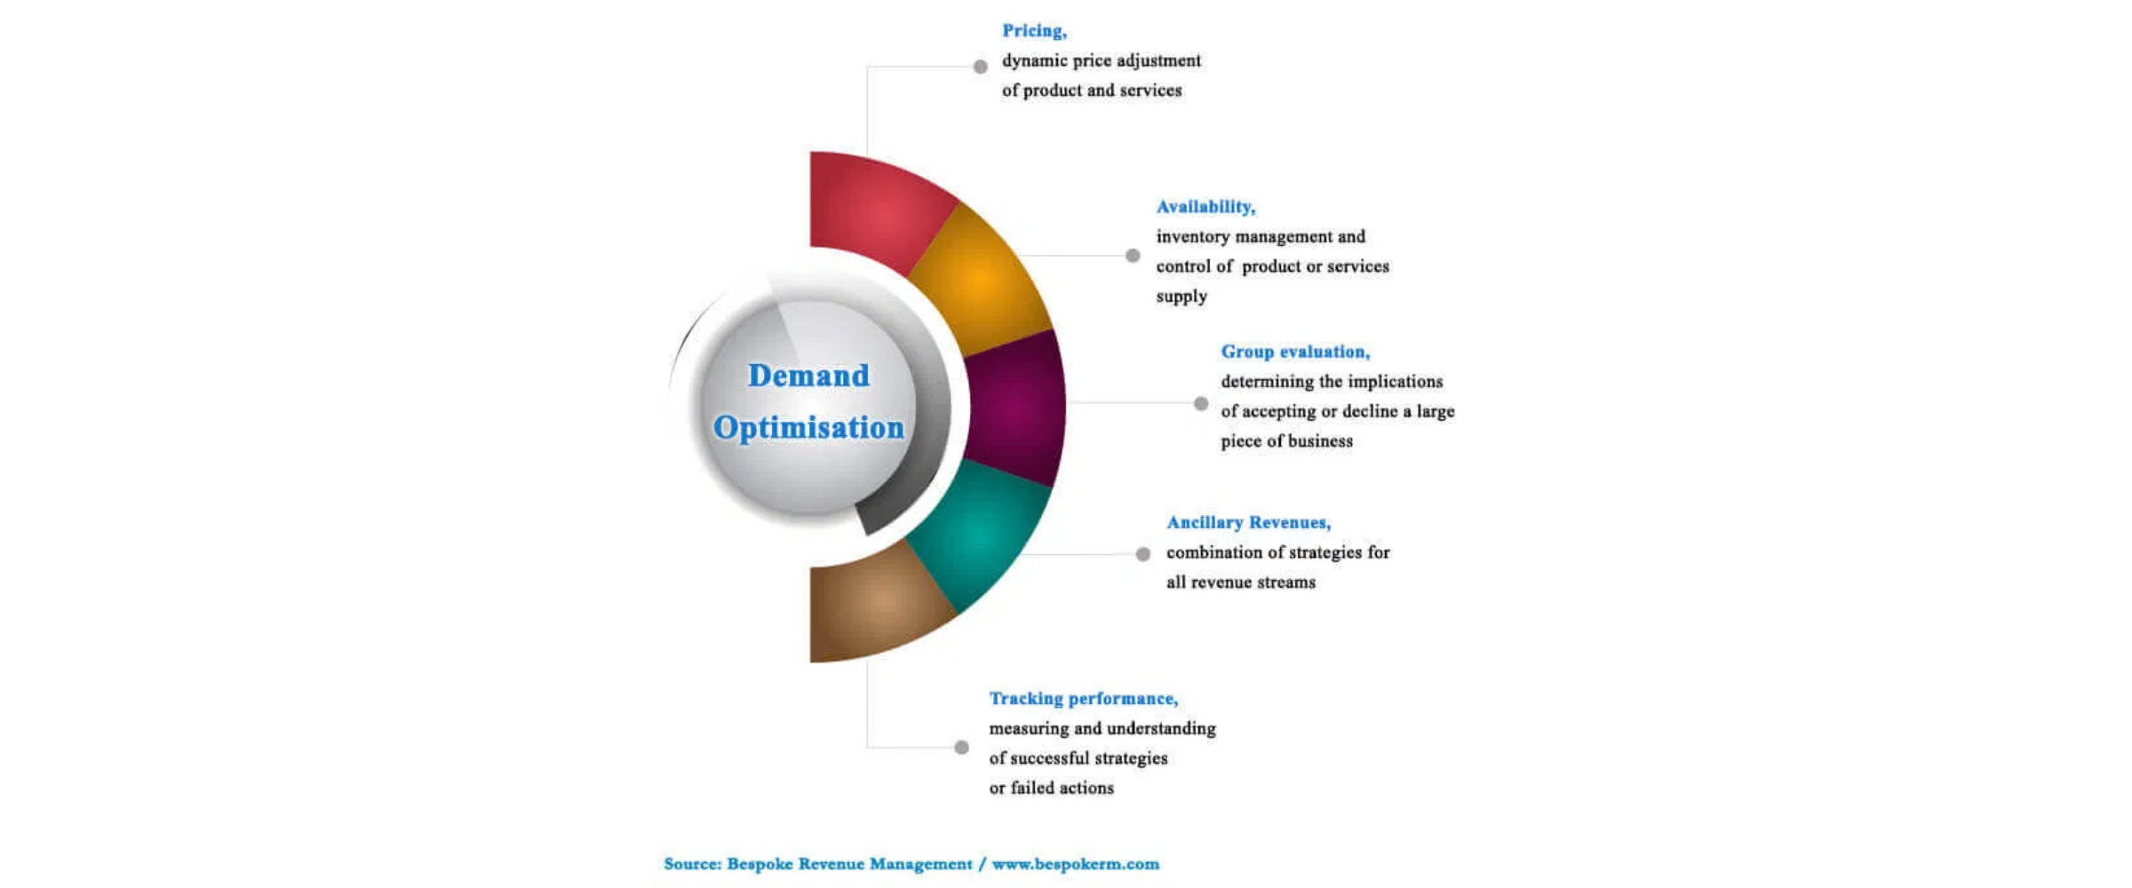




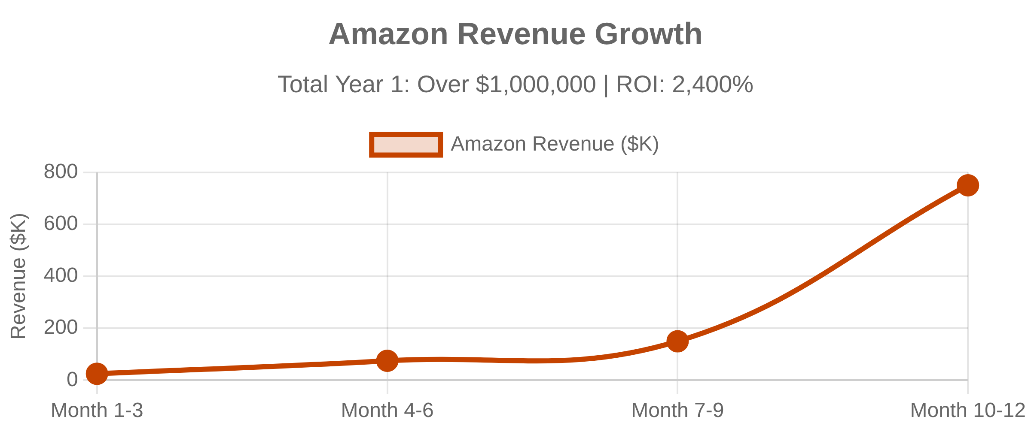







Case Study: $1M Amazon Success
Real Client Results from Assessment Implementation
Client Profile
Industrial supply company
$15M annual revenue
Traditional B2B sales model
Limited online presence
Assessment Findings
Digital Presence Score:
45/120 (38%)
Revenue Optimization Score:
52/150 (35%)
Key Gap:
No Amazon marketplace presence
Opportunity Identified:
$150K+ annual Amazon potential
Implementation Strategy
Amazon marketplace setup and optimization
Product listing optimization
Key Success Factors
Inventory management integration
Systematic assessment identified specific opportunity
Advertising campaign development
Professional implementation with proven methodology
Ongoing optimization and performance monitoring
Integration with existing business operations

Slide 9





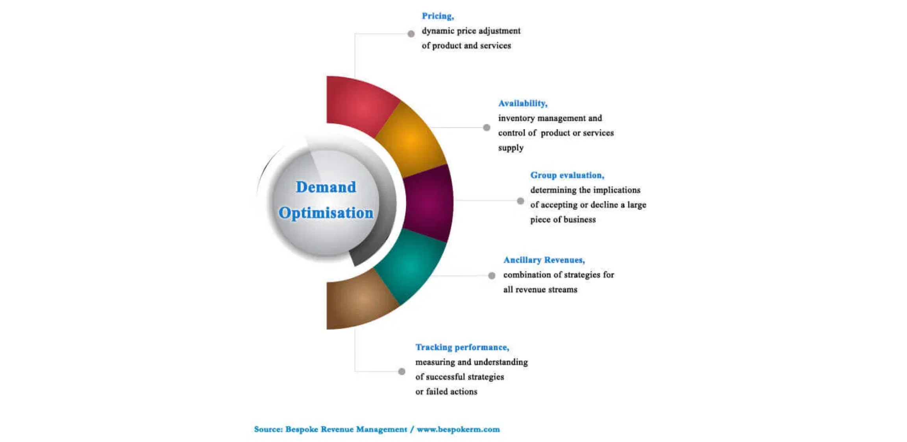
Implementation Strategy
Phased Approach for Maximum Results
Phase 1: Quick Wins
(30 Days)
Phase 3: Growth Initiatives
(90 Days)
Focus: Immediate impact improvements
Focus: Scaling and expansion
Website lead capture optimization
Google My Business setup
Paid advertising campaigns
Partnership development
Product/service expansion
Advanced analytics implementation
Basic analytics implementation
Review generation campaigns
Expected Results:
20-50% improvement in lead generation
Expected Results:
100-200% revenue growth
Investment:
$2K-5K
Investment:
$10K-25K
ROI:
300-500%
ROI:
500-800%
Phase 2: Foundation Building
(60 Days)
Phase 4: Strategic Expansion
(120+ Days)
Focus: Core system improvements
Focus: Market leadership
SEO content strategy implementation
Email marketing automation
Market expansion strategy
Technology infrastructure upgrade
Sales process documentation
Customer retention programs
Brand authority building
Innovation pipeline development
Expected Results:
40-80% improvement in conversion rates
Investment:
$5K-15K
Expected Results:
200-500% business transformation
ROI:
400-600%
Investment:
$25K-50K
ROI:
600-1000%

Slide 10


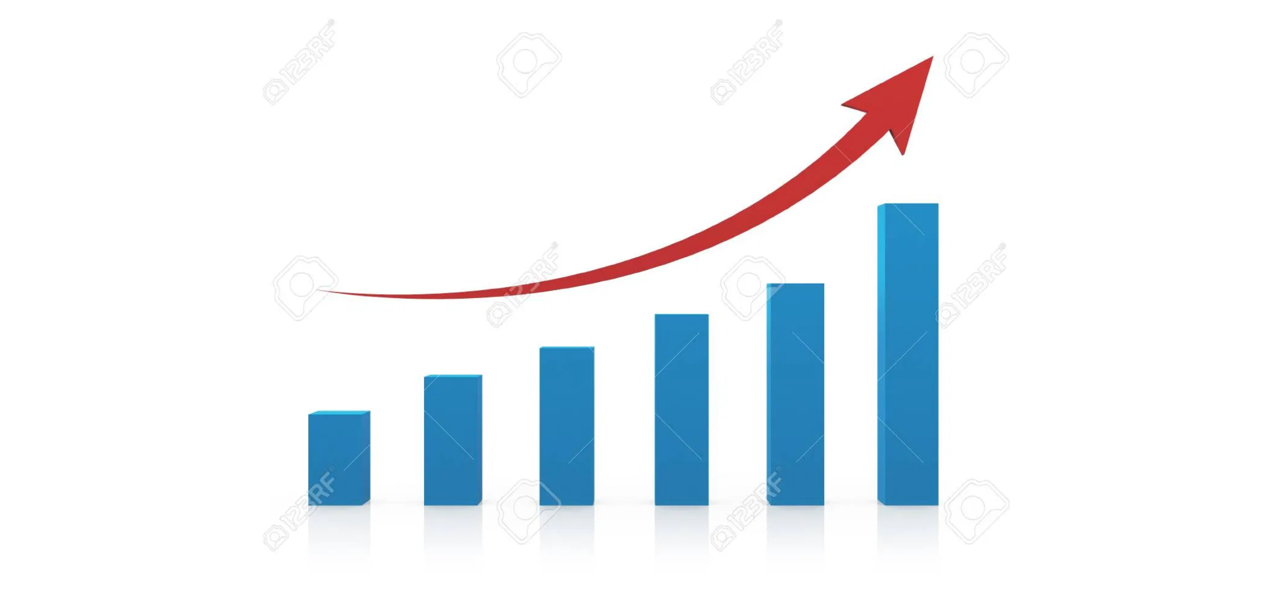






Next Steps & Professional Support
Qualification for Strategic Consultation
Strategic Consultation Available
Complimentary for Qualifying Businesses
What's Included:
Detailed review of your assessment results
Custom implementation roadmap development
ROI projections and timeline planning
Professional service option evaluation
Professional Service Tiers:
Qualification Criteria:
Business Accelerator
Business Expansion
Annual Revenue: $1M+
• Target: $5M-20M companies
• Target: $20M-35M companies
Identified Opportunities: $50K+ annually
• Setup: $5,000
• Setup: $8,000
Decision Authority: For business investments
• Monthly: $2,500
• Monthly: $4,000
• ROI: 250-400%
• ROI: 300-500%
Implementation Commitment: Within 90 days
Business Transformation
Enterprise Solutions
• Target: $35M-50M companies
• Foundation: $5,000/month
• Setup: $12,000
• Growth: $8,500/month
• Monthly: $6,500
• Transformation: $15,000/month
• ROI: 400-600%
strategy@nexgenwebcreators.com
www.nexgenwebcreators.com/strategy
Schedule Your Strategic Consultation Today

