Slide 1

Beauty Professional
Career Success
Workshop
Transform Your Passion Into a Thriving Business
Presented by
Nexgen Webcreators
Licensed BeautyProfessional & Business Mentor

Slide 2

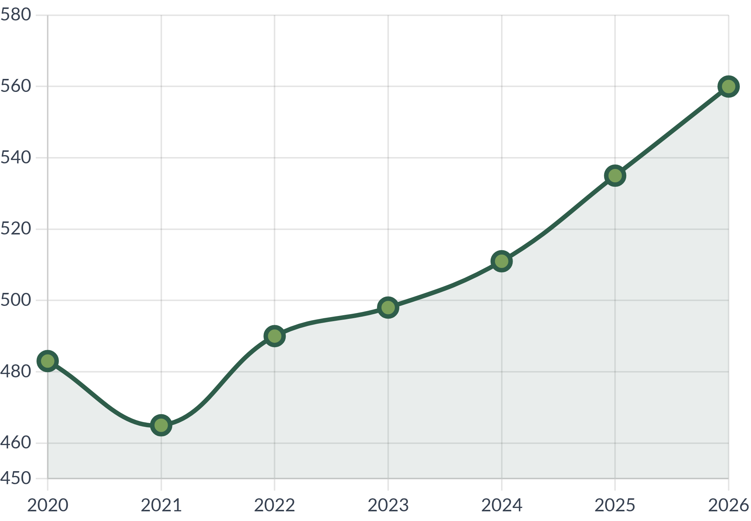
Beauty Industry Landscape
Market Overview
Industry Growth Projection
Global Market Size (2024)
$511 Billion
Annual Growth Rate
4.75%
US Employment
1.2 Million
Career Opportunities
85% become independent contractors within 5 years
Average salon owner income: $75,000+
Flexible scheduling and creative freedom
Growing demand for specialized services
Source: IBISWorld Beauty Industry Reports 2024

Slide 3




Entrepreneurial Mindset
Think Like an Entrepreneur
• View yourself as a business owner, not just a service provider
• Focus on solving client problems and creating value
• Embrace continuous learning and skill development
• Build systems that work without your constant presence
Growth Mindset Principles
• Failures are learning opportunities, not setbacks
• Invest in yourself before expecting others to invest in you
• Network with other professionals and business owners
• Set measurable goals and track your progress
Building Confidence
• Start with friends and family to build your portfolio
• Document every success and positive feedback
"Success in beauty is about more than technical skills—
• Charge what you're worth—don't undervalue your skills
it's about building relationships and creating experiences."
• Remember: every expert was once a beginner

Slide 4





Business Setup Essentials
Legal Business Structure
BUSINESS LICENSE
Sole Proprietorship:
Simplest, but personal liability
LIABILITY INSURANCE
LLC FORMATION
LLC:
Protects personal assets
S-Corporation:
Tax benefits for higher income
APPROVED
Insurance Requirements
Professional Liability:
Protects against negligence
General Liability:
Covers accidents & injuries
Product Liability:
For retail product sales
Licenses & Permits
Cosmetology License
Business License
EIN Number
Salon Establishment
Tax Considerations
Self-Employment Tax:
15.3% for Social Security/Medicare
Quarterly Estimated Taxes:
Required for self-employed
Business Deductions:
Equipment, supplies, education

Slide 5


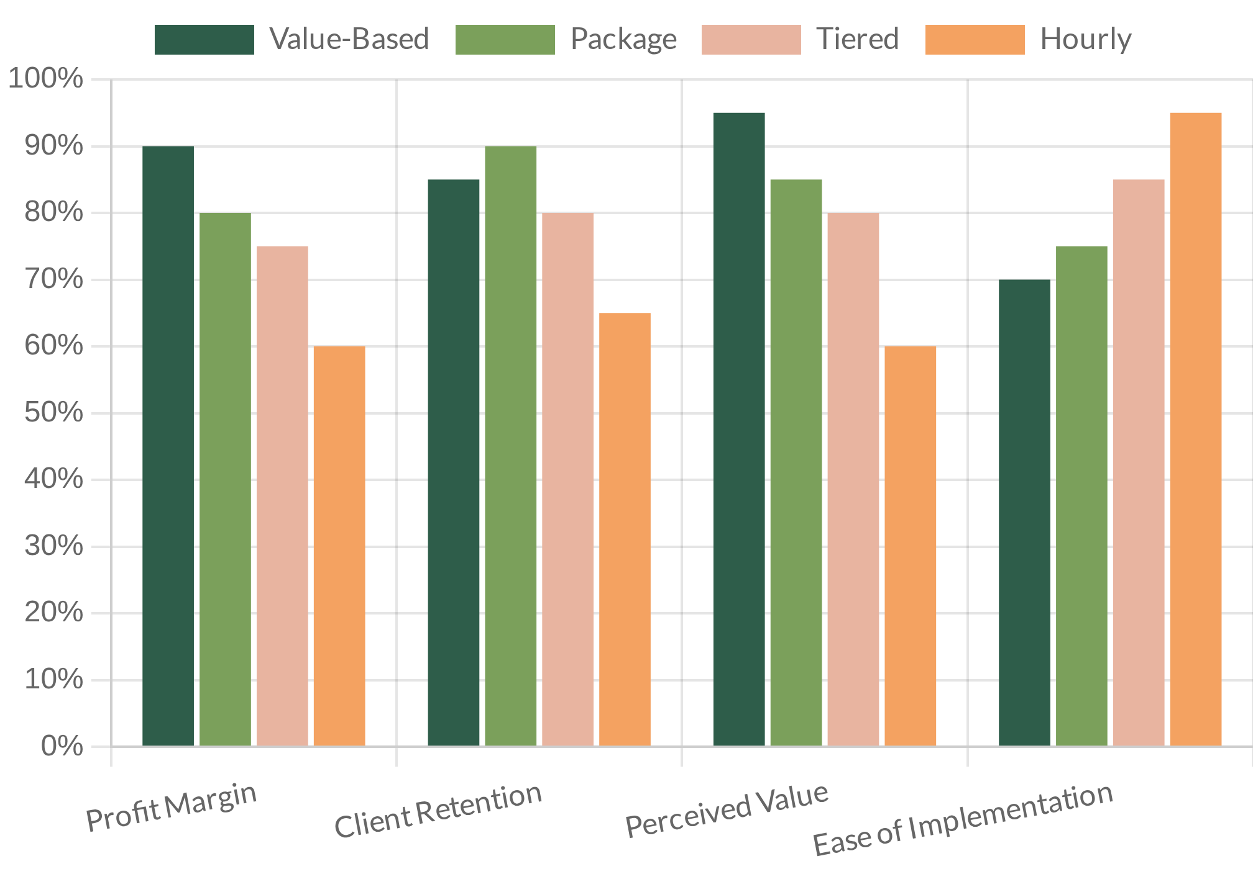


Pricing Your Services
Pricing Models Comparison
Calculating Your Base Rate
Your minimum hourly rate should cover:
• Expenses (products, tools, rent) + 30%
• Your desired annual salary ÷ working hours
• Taxes and insurance costs
• Education and skill development
Psychology of Pricing
• Clients equate higher prices with higher quality
• Odd pricing ($99 vs $100) works for retail, not services
• Anchor high-end services to make mid-tier seem reasonable
• Focus on value and results, not time or product cost
Value-Based:
Price based on client perceived value and results
Package:
Bundled services at a slight discount
Tiered:
Good/Better/Best service options
Common Pricing Mistakes
Hourly:
Fixed rate per hour of service
• Undercharging to compete with established professionals
• Not accounting for all business expenses
• Failing to raise prices as skills improve
• Offering too many discounts that devalue your work

Slide 6


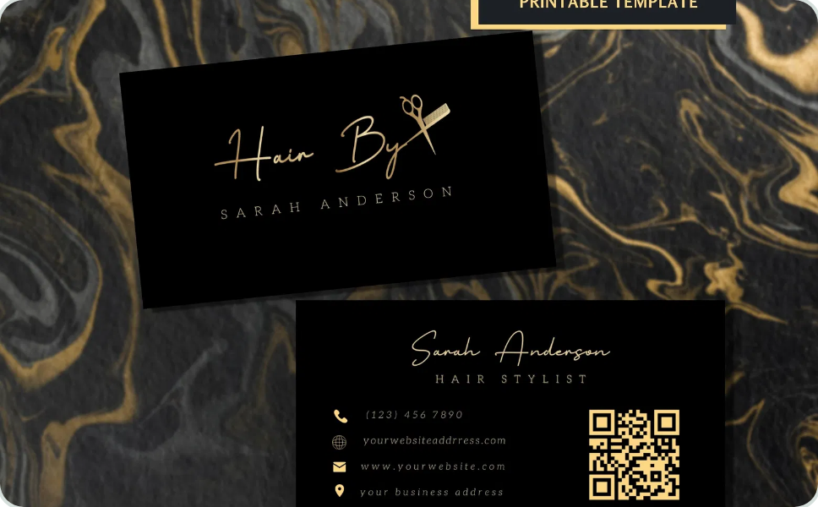
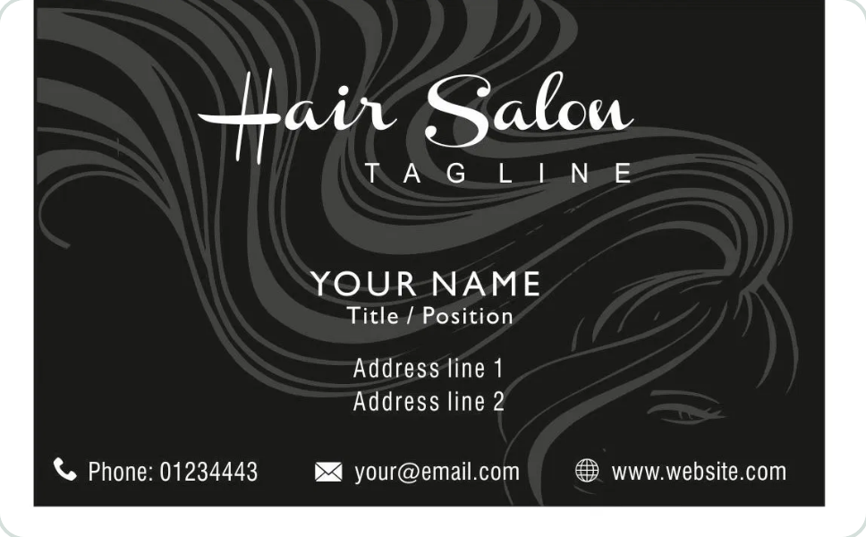



Building Your Brand Identity
Brand Elements
Core Brand Elements
•
Logo:
Simple, memorable, works at any size
•
Color Palette:
2-3 primary colors + 2-3 accent colors
•
Typography:
Consistent fonts across all materials
•
Imagery Style:
Consistent photo editing and composition
Sample Color Palette
Brand Voice & Personality
• Define your brand's tone: professional, friendly, luxurious, etc.
Consistent Social Media
• Create a consistent writing style for all communications
• Develop a unique perspective that differentiates you
• Align your personality with your target client's expectations
Brand Consistency
• Use the same visual elements across all platforms
• Create templates for social media posts and stories
• Develop a brand style guide for reference
• Ensure all client touchpoints reflect your brand identity

Slide 7

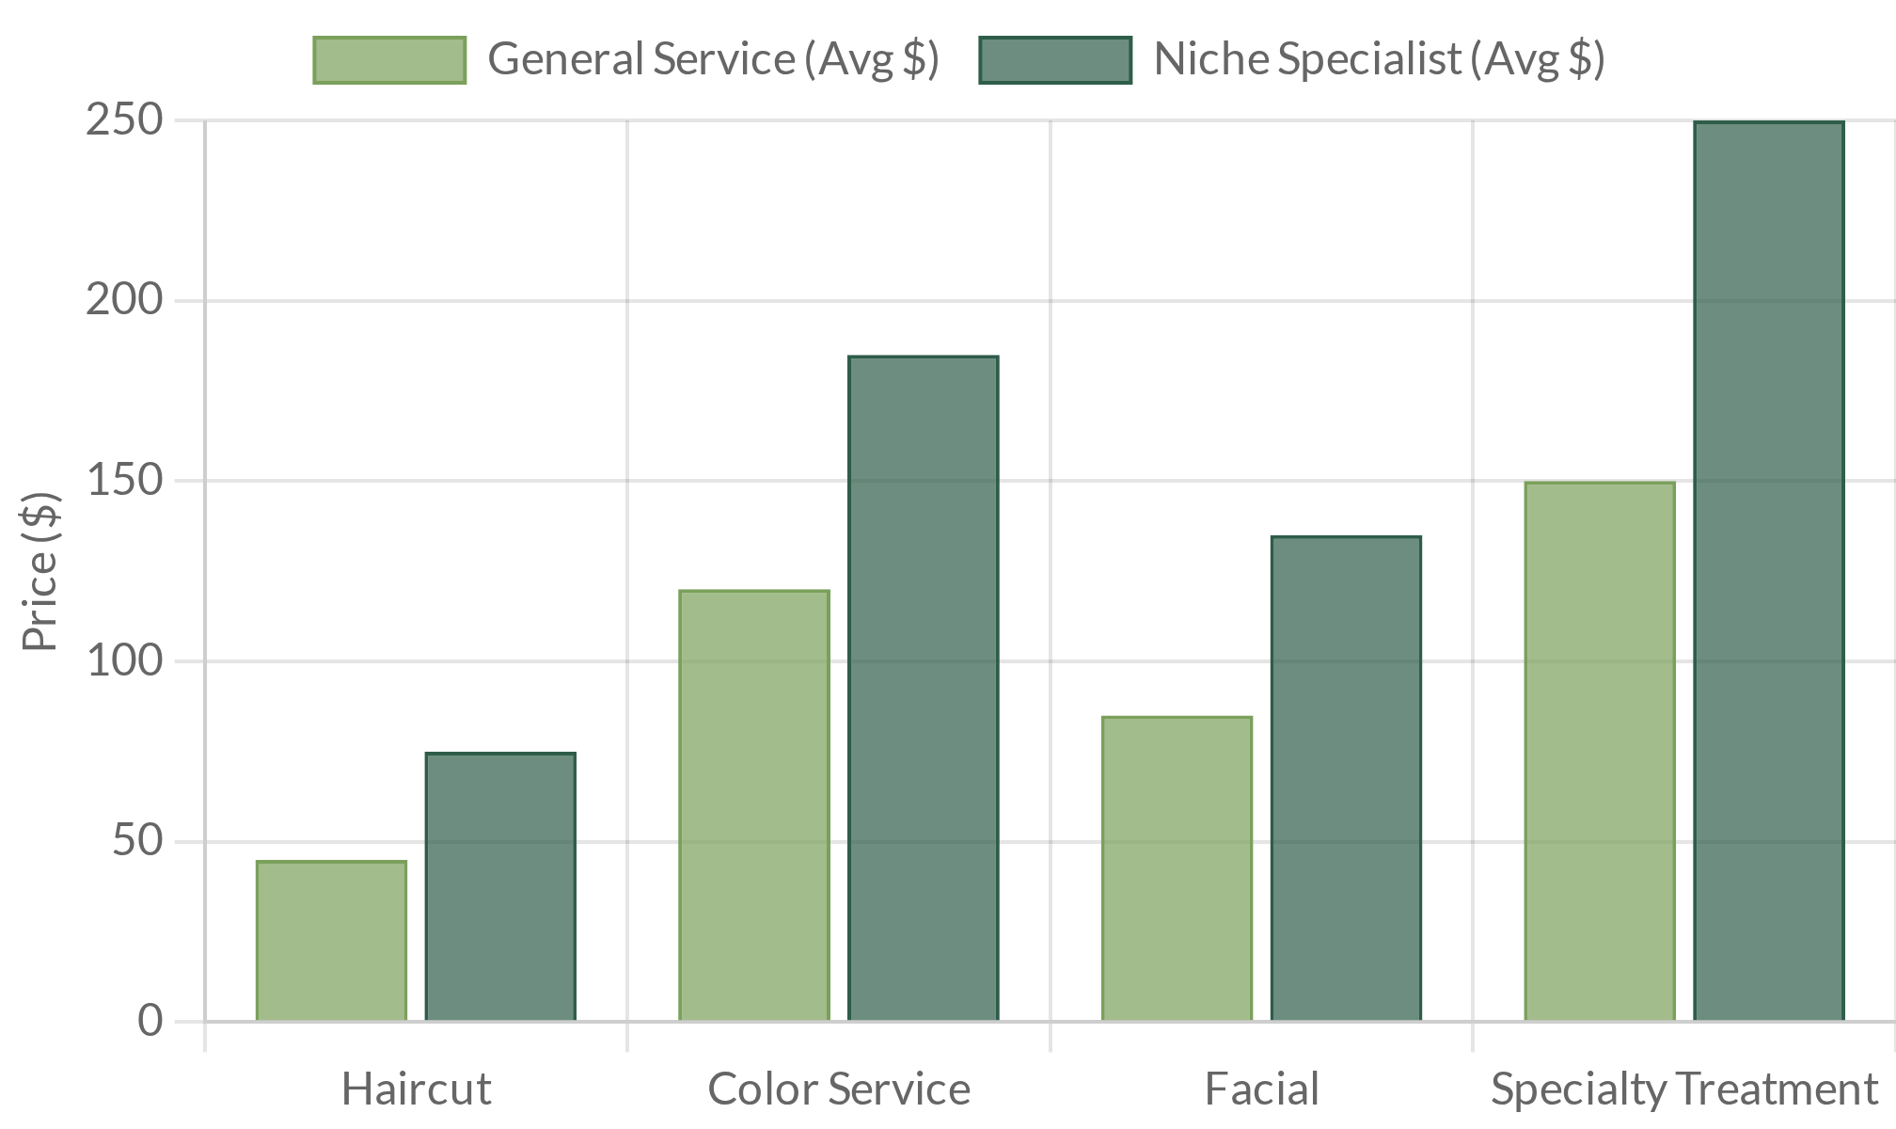






Finding Your Niche
Specialization creates higher demand and premium pricing opportunities
Profitable Niche Markets
Niche vs. General Pricing
Holistic Beauty
Organic products, mental health focus, wellness integration
Neurodivergent-Friendly
Quiet hours, sensory-friendly environment, weighted blankets
Permanent Makeup
Cosmetic tattoos, microblading, lip blushing
Japanese Head Spa
Scalp treatments, head massage, hair restoration
Mobile/Home Services
Hospice care, postpartum, elderly, mobility challenges
Source: Beauty Industry Association Market Report 2023
Benefits of Specialization
Less competition
Higher client loyalty
Premium pricing
Targeted marketing
Word-of-mouth referrals
Expert reputation

Slide 8


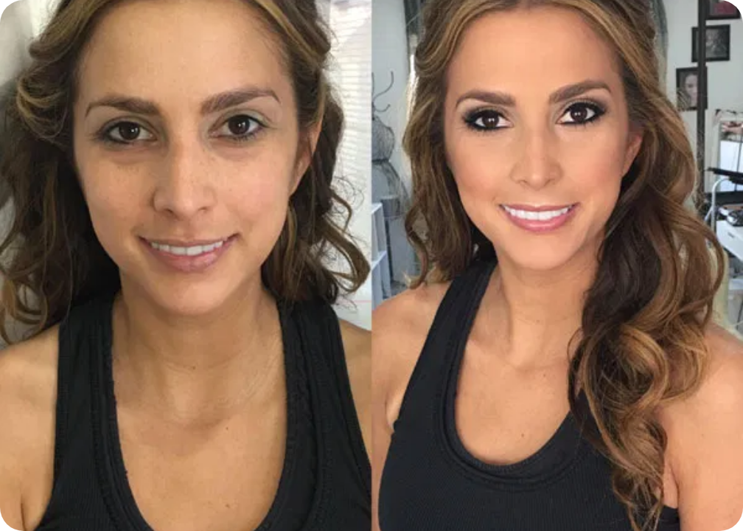
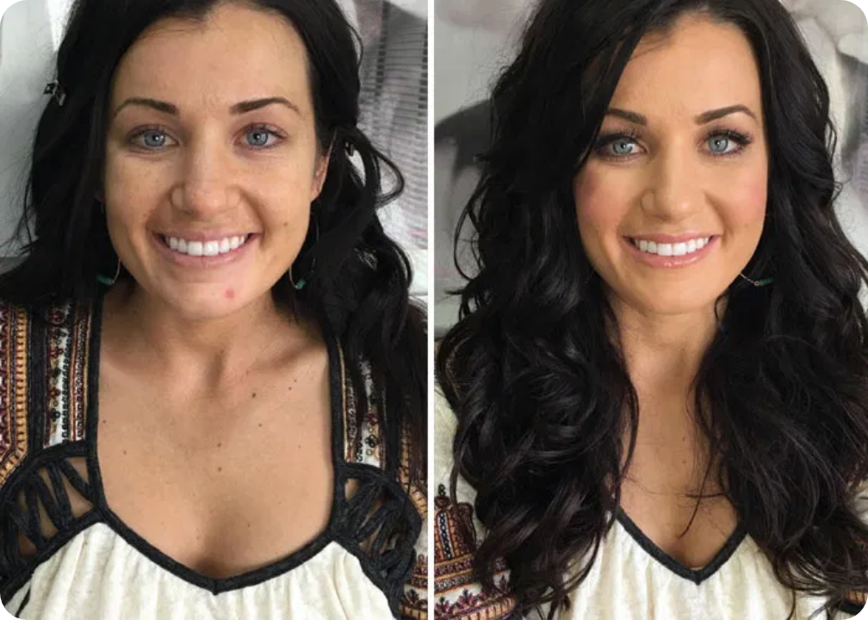



Professional Portfolio Creation
Before & After Examples
Essential Portfolio Content
Before & After Photos:
Document transformations
Process Videos:
Show your technique and expertise
Client Testimonials:
Written and video reviews
Portfolio Organization
Makeup Transformation
Hair Styling
Categorize by Service:
Group similar services
Consistent lighting and angles show true transformation
Highlight Specialties:
Feature unique skills
Multiple angles demonstrate attention to detail
Update Regularly:
Add new work monthly
Photography Tips
Using Your Portfolio
Use natural light whenever possible
Share on social media with relevant hashtags
Maintain consistent background and distance
Feature on your website and booking platforms
Always get client permission before sharing
Include in client consultations to set expectations

Slide 9











Social Media Marketing
Successful Beauty Profiles
Platform Strategy
Instagram:
Portfolio
Facebook:
Client reviews
showcase
TikTok:
Quick tutorials
Pinterest:
Inspiration
Content Planning
Professional Portfolio Layout
Content Mix:
60% portfolio, 20% education
Consistent grid design with color coordination
Posting Frequency:
3-5 times weekly
Pro Account
Engagement Tactics
Access analytics
Respond to Comments:
Within 24 hours
Branded templates
Track insights
Use Local Hashtags:
Target your service area

Slide 10








Essential Digital Tools
BeautyBooker Pro
Online Booking Systems
Automate scheduling and reduce no-shows
Today's Appointments
June 15, 2025
•
Options:
Schedulicity, Vagaro, Acuity
Sarah Johnson
•
Features:
24/7 booking, reminders
9:00 AM - Hair Color & Cut
•
Cost:
$15-45/month
Michael Chen
11:30 AM - Men's Style & Beard
Client Management Software
Taylor Williams
Track client history and preferences
2:00 PM - Balayage & Blowout
•
Options:
Salon Iris, GlossGenius
•
Features:
Client profiles, history, notes
Client Notes
•
Benefits:
Personalized service
Sarah: Sensitive scalp - use gentle formula. Prefers coffee while processing. Allergic to almond products.
New Booking
Refresh
Settings
Financial & Marketing Tools
Manage payments and grow your business
•
Payments:
Square, Clover, SumUp
•
Accounting:
QuickBooks, Wave
•
Marketing:
Mailchimp, Later, Buffer

Slide 11






Marketing & Client Acquisition
Marketing Materials
Referral Program Setup
GRAND OPENING
• Create generous incentives
• Make sharing easy
50% OFF
• Track referrals in software
• Thank clients personally
BOOK NOW
Professional Business Cards
Digital Marketing
Digital Marketing Tactics
• Post before/after photos
• Use local hashtags
Refer a Friend
• Create educational content
• Engage with followers
20%
+
20%
FOR YOU
FOR FRIEND
Client Retention Techniques
Referral Program Example
• Send follow-up messages
• Create loyalty program
• Offer birthday specials
• Pre-book next appointments
Local Marketing
• Partner with local businesses
• Join community groups
• Offer services at events
• Create Google Business profile

Slide 12




Your 30-60-90 Day Action Plan
First Week Quick Wins
30
Foundation Building
Create Business Name & Logo
Set up legal business
Establish your visual identity and brand foundation
structure
Create initial portfolio
Set Up Instagram Business Account
Establish social
Create profile, add portfolio photos, write compelling bio
media presence
Set up booking
Take Before/After Photos of 3 Clients
system
Build initial portfolio with friends and family if needed
60
Growth & Expansion
Implementation Priorities
Launch referral
program
Legal & Financial Setup
Implement pricing
Business license, insurance, separate bank account
strategy
Create content
Client Experience Design
calendar
Booking process, service protocols, follow-up system
Network with
industry professionals
Marketing Materials
Business cards, digital flyers, referral cards
90
Optimization & Scale
Success Metrics
Analyze client
acquisition data
30 Days:
60 Days:
Refine service
5+ portfolio examples
10+ paying clients
offerings
Business structure set up
5+ positive reviews
Develop advanced
100+ social followers
Referral program active
skills
90 Days:
Accountability:
Create 6-month
25+ regular clients
Weekly progress review
business plan
50% booking rate
Monthly goal setting
Profitable pricing model
Find accountability partner

